Slide 1
Mission Bay School Access Plan
Mission Bay School Workshop
Feb 24, 2024
Notes:
Hello everyone, thanks for joining and for that introduction.
I’m David Long, senior TP for the San Francisco County Transportation Authority. I’ll be managing this project and presenting today. I’ll also acknowledge a few other colleagues on this call.
Daniela Rible is a senior communications manager at the SFCTA and will be assisting with outreach. Mike Sallaberry is a senior transportation engineer with the SFMTA who our partners on this project. His team at the SFMTA will be leading concept development for this effort, which I’ll say more about in a minute.
Finally, Tiffany Gong, SFUSD’s architect has joined.

Slide 2
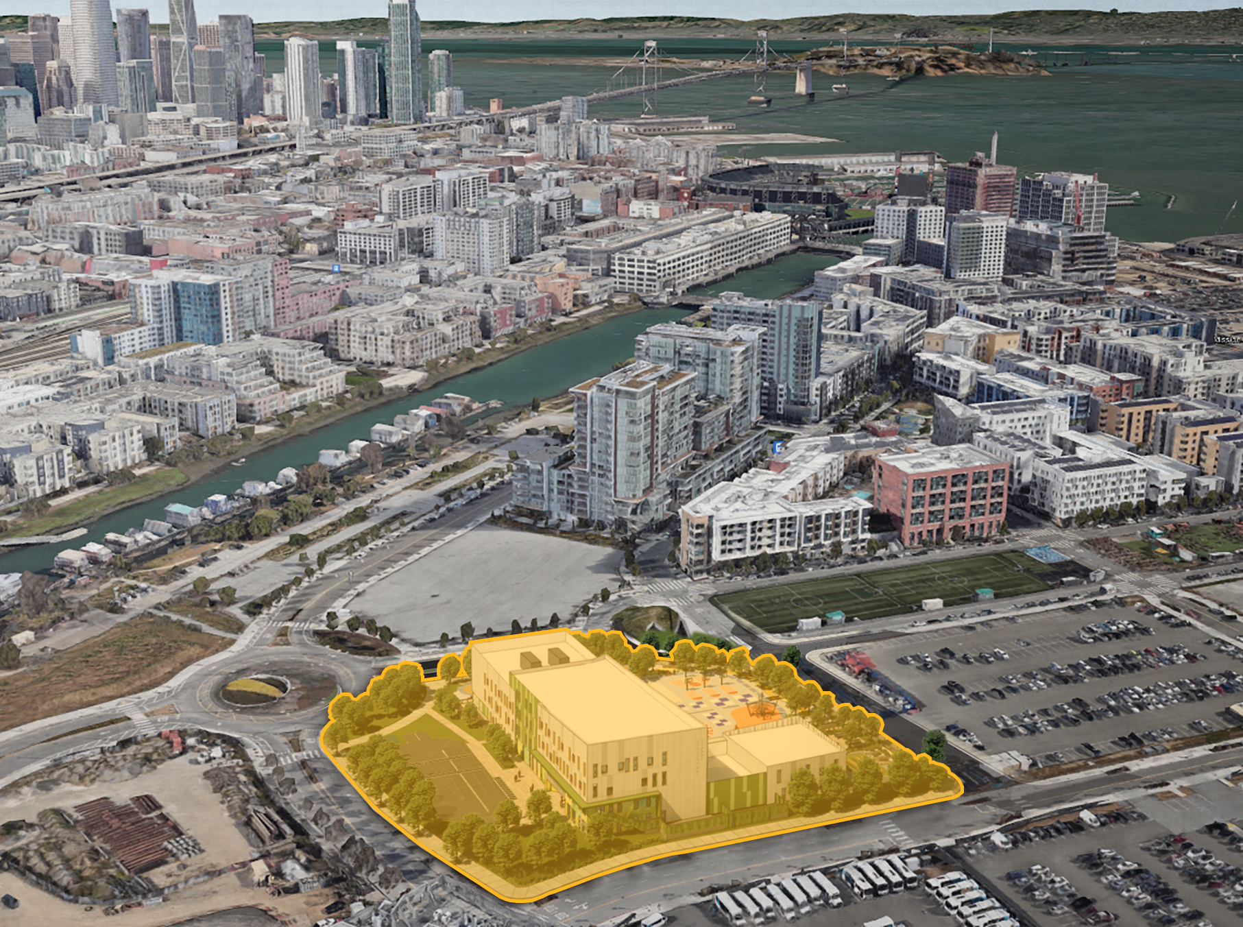
New Mission Bay School
      Complete June 2025
      TK-5 School
      Professional Development Center for High Schoolers
      Professional Learning Center for Teachers and Staff
Rendering courtesy of SFUSD
Notes:
I won’t linger here because I know you all are intimately familiar with this project, but it is the impetus for our effort:
SFUSD is building a new elementary school in MB. They currently hoping to complete construction in 2025.
Besides the elementary school, the building will also contain a professional development center for high schoolers as well as professional development resources for staff.

Slide 3
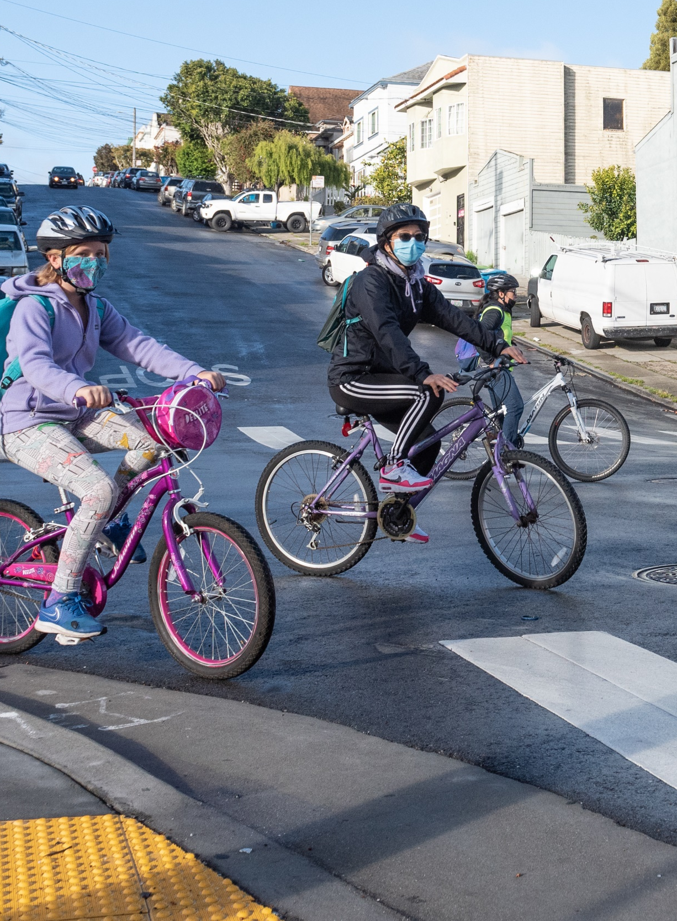
Mission Bay School Access — Scope
Project Goals
    Safety
    Connectivity
    Accountability
      Robust Engagement
      Feasible Recommendations
Core Scope
    Identify “Key Barriers”
    Design 1 – 2 solutions
    Identify road segments which need improvements to connect the school site to SF’s Broader active network
Photo by SFMTA Photography Department
Notes:
So, how does the Mission Bay School Access Plan propose to improve on these existing conditions?
Start with our project goals. These will be used to guide concept designs and recommendations. We’ve just covered some of the safety and connectivity conditions, but our third study goal is accountability. To us that means ensuring a robust engagement process, and that we bring forward feasible recommendations complete with an implementation and funding plan.
Our Core study scope involves three steps:
- Identify “Key Barriers”, then
- Design 1-2 solutions for most acute barriers. Commissioner Dorsey’s office has set aside $90k for implementation. It’s not enough to complete a major street or intersection redesign, but it could be used as matching funds for competitive grants, or to advance detailed design as additional funds are lined up
- Beyond 102 design solutions, we will also identify road segments which need improvements to connect to the school site’s broader transportation network

Slide 4
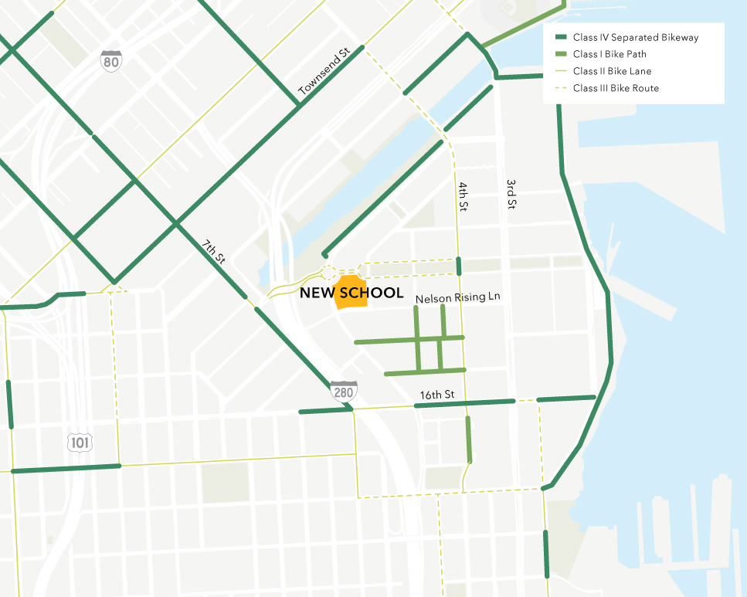
Connecting to Sustainable Transportation
    The Mission Bay School Access Plan will ensure school site is well connected to San Francisco’s active transportation network and nearby transit
Notes:
This is a great thing, but Getting the new school via sustainable transportation under existing conditions isn’t trivial. This is where my agency comes in and this effort comes in. District 6 Supervisor and transportation authority commissioner Matt Dorsey has requested the San Francisco County Transportation Authority ensure the school is well connected sustainable transportation, especially to the city’s bicycle network.
The map we see here is the existing bicycle network. Darker lines indicate higher quality facilities.
We see that there are some high-quality facilities relatively near the school site, but that these generally fail to connect to the school itself. Mission Bay Drive is the only street on San Francisco’s existing active transportation network which connects to the school site, but it’s what we call a “class 3 facility” meaning that people biking share road space with vehicles. Mission Bay Drive, passing underneath I-280 has bicycle lanes, but the connection is not contiguous.

Slide 5
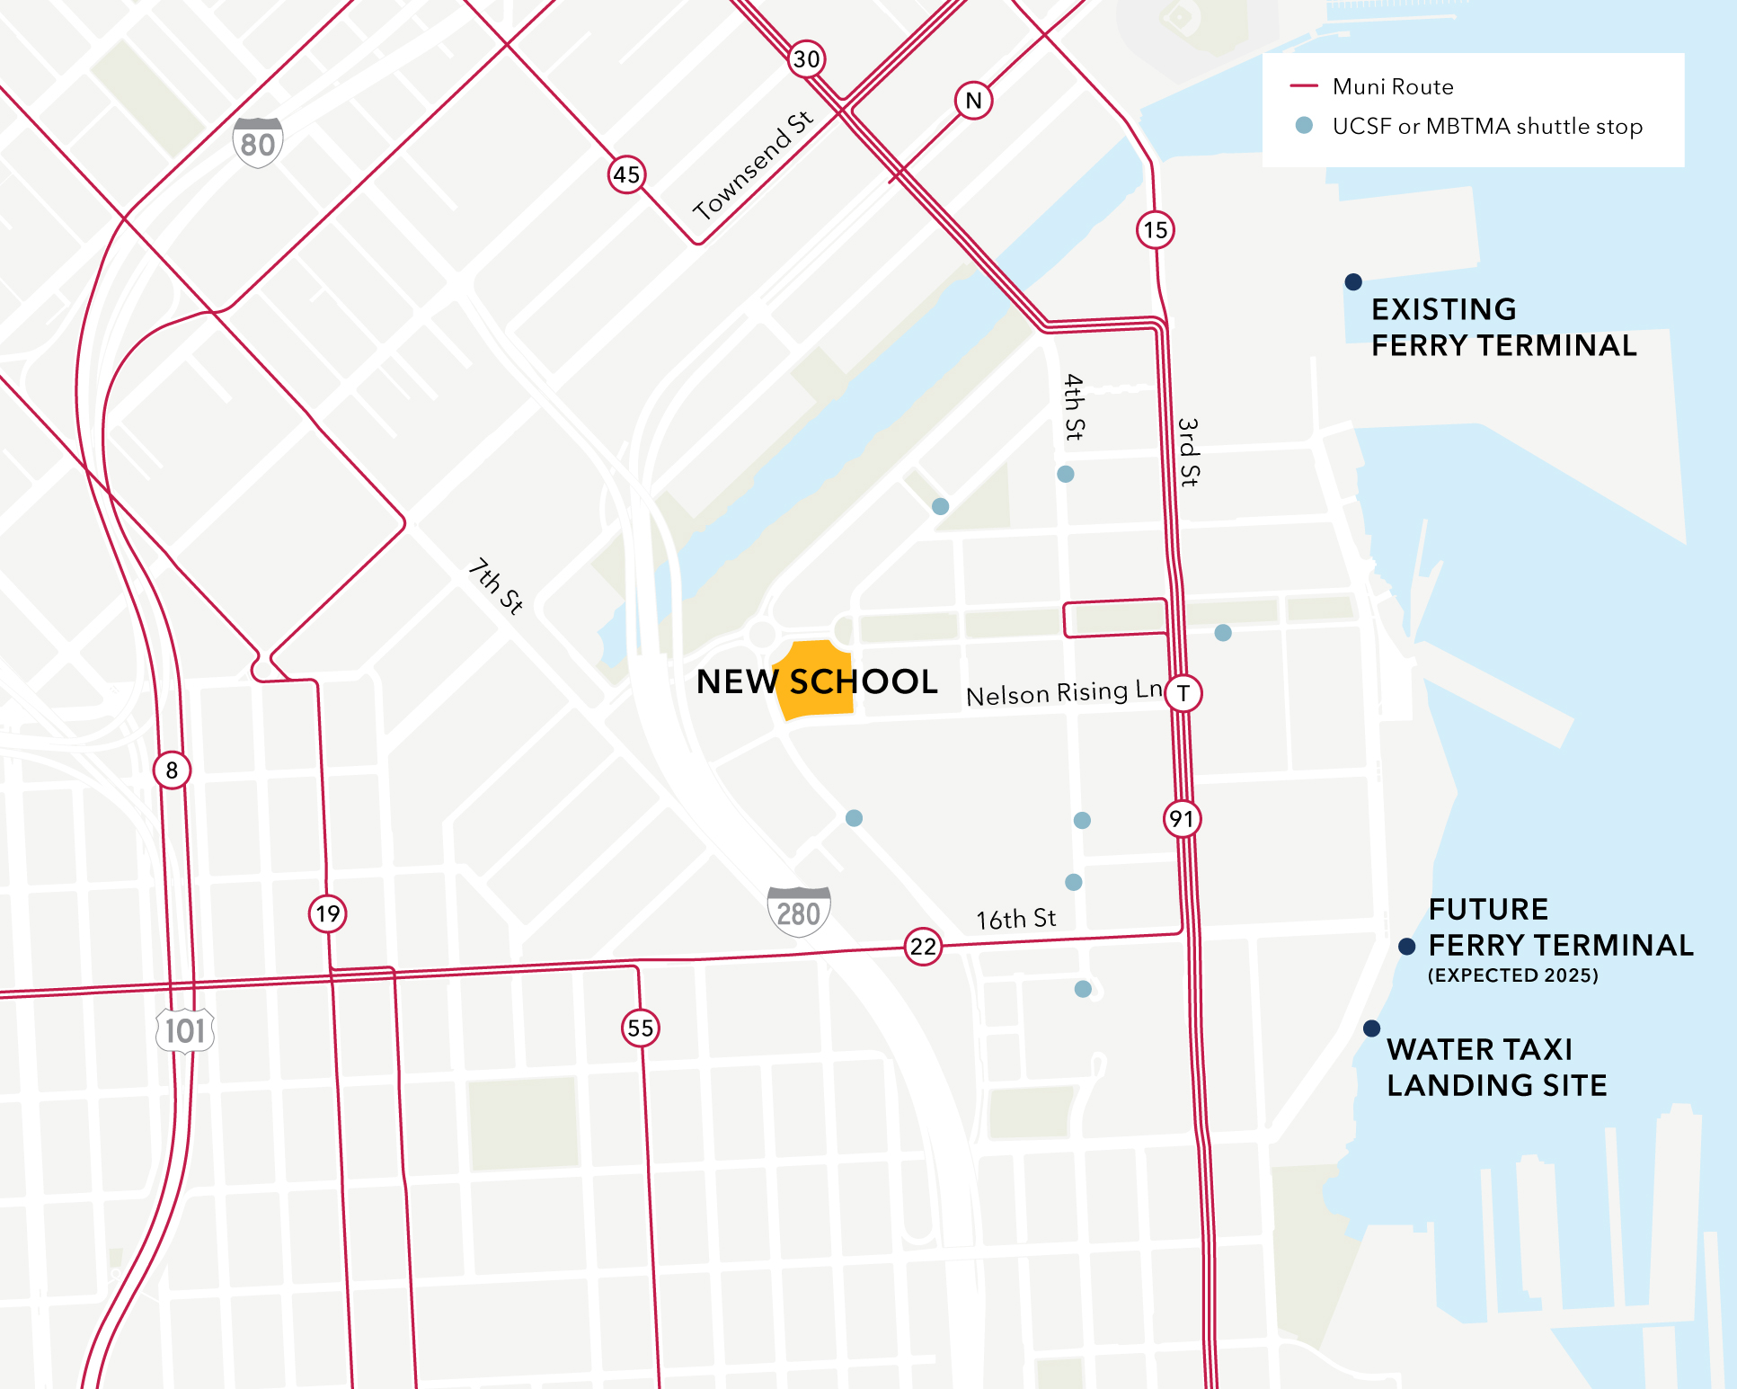
Connecting to Sustainable Transportation
    The Mission Bay School Access Plan will ensure school site is well connected to San Francisco’s active transportation network and nearby transit
Notes:
If we look at transit we, we see that Mission Bay is served by several Muni lines.
The neighborhood is also served by quite a few shuttles. Stops here are indicated with light blue dots.
These shuttles are operated by both UCSF and the Mission Bay Transportation Management Association
We want to work with these private shuttle operators to understand whether there are opportunities to serve students and caregivers while ensuring comfortable walking routes from existing SFMTA transit.

Slide 6
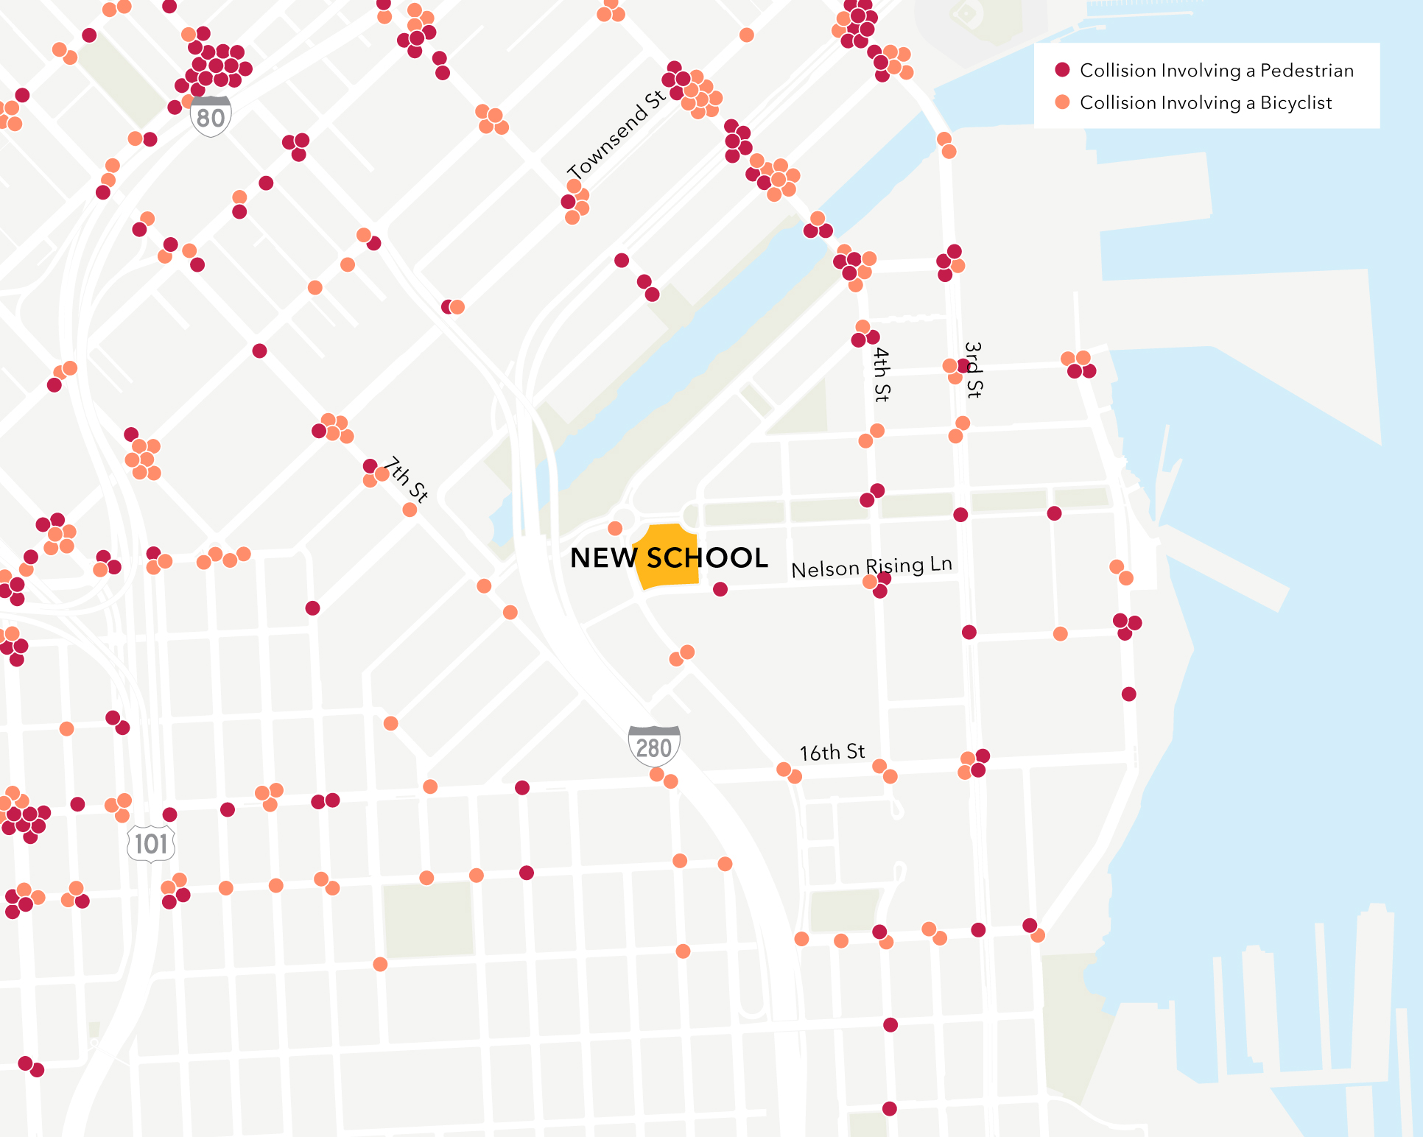
Make Connections Safe for All Ages and Abilities
    Ensure connections to the school site are safe for people riding and walking of all ages and abilities
Notes:
Besides better connecting connecting the school to sustainable transportation, we’re also looking to ensure connections are safe for all ages and abilities
Here you see collisions which involved a pedestrian or bicyclist.
The key take away from this map is that collisions involving bicycles and pedestrians have occurred throughout the Mission Bay neighborhood, but have been concentrated along Mission Bay’s arterial corridors including 3rd Street, 4th Street, and 16th Street. Of course, this could change as the new school opens, shifting trip patterns.
We also see that within ¼ mile of the school site, there have been more collisions between vehicles and cyclists than between vehicles and pedestrians.

Slide 7
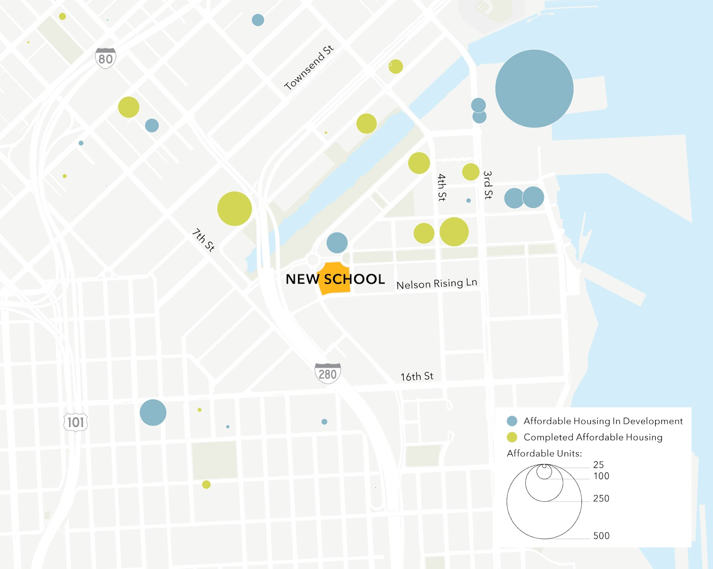
Connecting to Affordable Housing

Slide 8
Evaluation Framework
Goal | Objective
Safety | Improve low-comfort facilities with a history of collisions
 | Provide an active transportation network which feels safe to the widest possible range of ages and abilities
Connectivity | Connect the Mission Bay School site to the broader citywide active transportation network
 | Ensure nearby affordable housing is well connected to the school site
Accountability | Incorporate local knowledge in both problem area identification and the development of solutions
 | Create transparency about trade-offs of alternative concepts, including related cost, construction duration, and construction impact

Slide 9
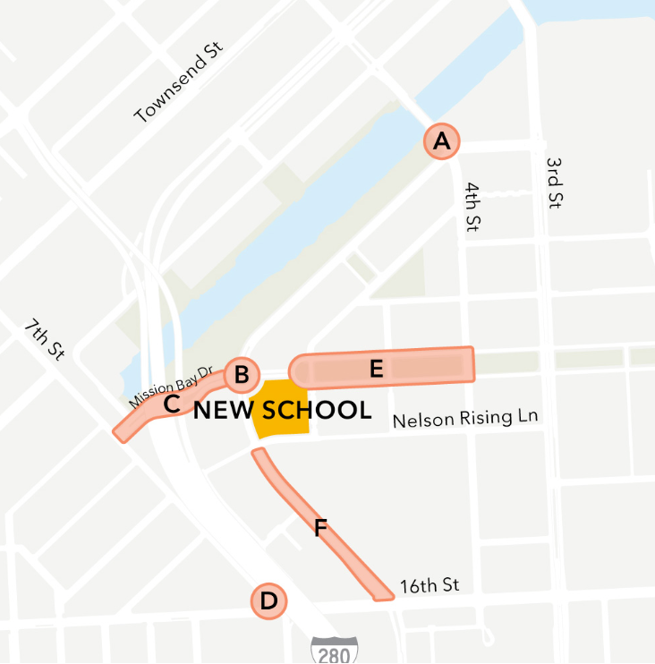
Preliminary Barrier ID
 | Collision History | Existing Facility Comfort | Connectivity Need | Proximity to School | Community Input | Prelim. Feasibility
A |  |  |  |  | ?
B |  |  |  |  | ?
C |  |  |  |  | ?
D |  |  |  |  | ?
E |  |  |  |  | ?
F |  |  |  |  | ?
 | = High Need
 | = Medium Need
 | = Low Need
Notes:
DO WE WANT TO ASK FOR COMMUNITY INPUT ON HOW TO WEIGH THE PRELIMINARY FEASIBILITY METRIC? Ie – WOULD YOU PREFER WE TACKLE THE SIMPLER ISSUES AND DELIVER PROJECTS MORE QUICKLY, OR IS THAT LESS IMPORTANT TO YOU?

Slide 10
What we need from you:
    Help Identifying “Key Barriers” to active transportation near the school site
    Help identifying what streets should be improved to best connect to school to existing transit and the bike network
    Feedback on how to weigh the Preliminary Feasibility metric: Would you prefer we tackle simpler barriers to deliver projects quickly, or take on more challenging areas for which it could take longer to implement solutions?
Notes:
Open for comments and questions here. Take appromixately 5.
Conclude and lead people to Baords

Slide 11
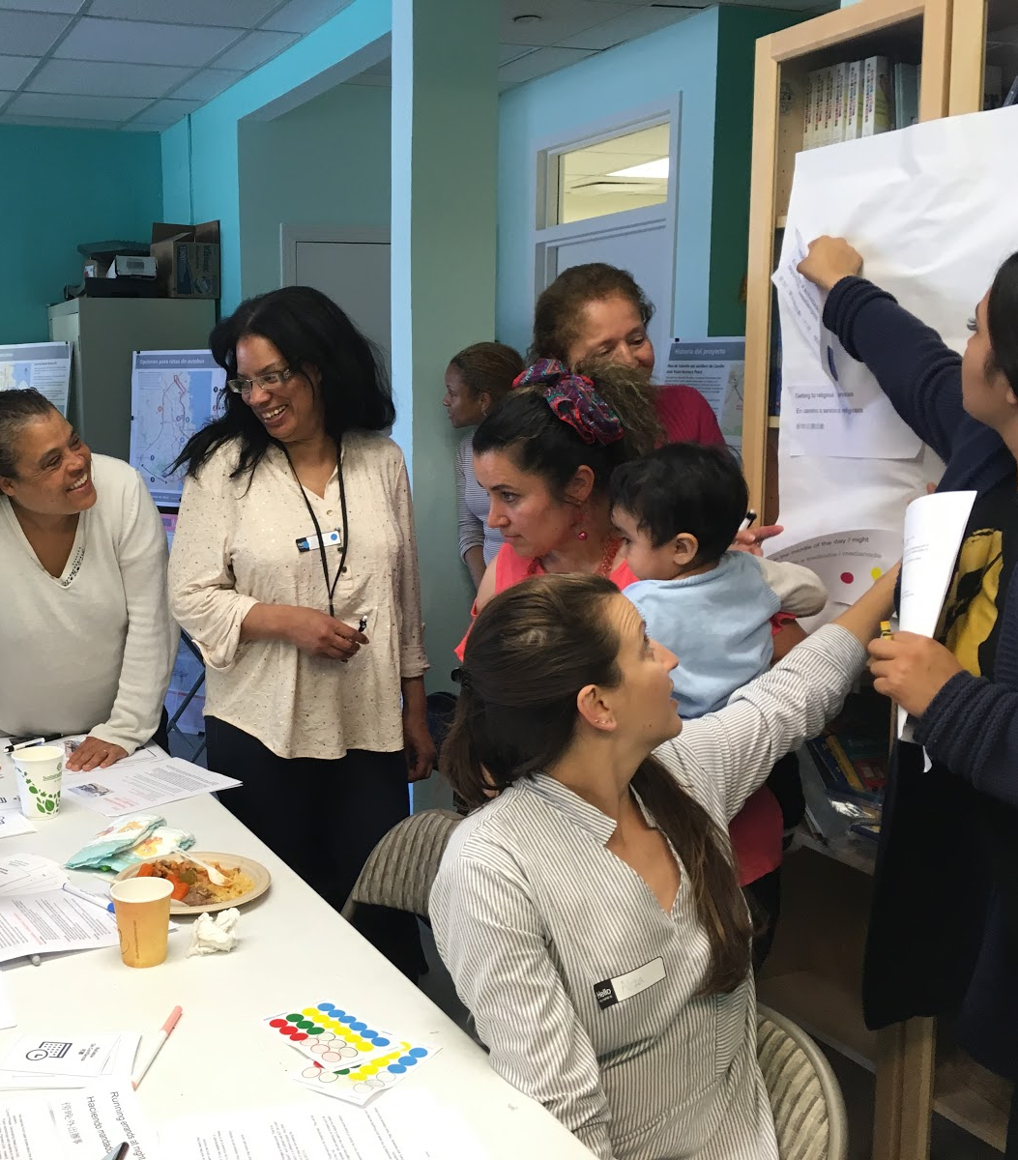
What’s next
      Team will use what we learn to identify key barriers and other roads that need to be improved, then design solutions
      Second round of engagement in the spring will bring forward ideas for solutions

Slide 12
Thank you.
  sfcta.org/mission-bay-school
David Long
  david.long@sfcta.org
  415-593-1669

